Slide 1
Analysis Summary and Recommendations
Introduction: Analyzing Medical Claims Data for Cost Reduction Opportunities
1
Objective: To present key findings and actionable recommendations derived from the analysis of medical claims data.
2
Agenda 1: Summary of Analysis Findings
3
Agenda 2: Recommendations for Cost Reduction

Slide 2
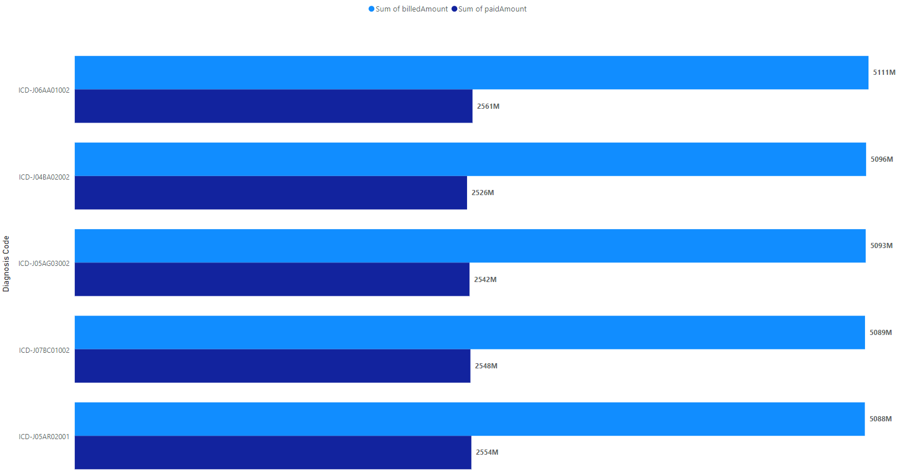
Top 5 Diagnosis based on Billed and Paid Amount
Top 5 diagnosis as shown in the chart below contribute to over 21bn amount. This indicates that very few of this diagnosis are driving high healthcare cost and may need further investigation with the healthcare providers.

Slide 3
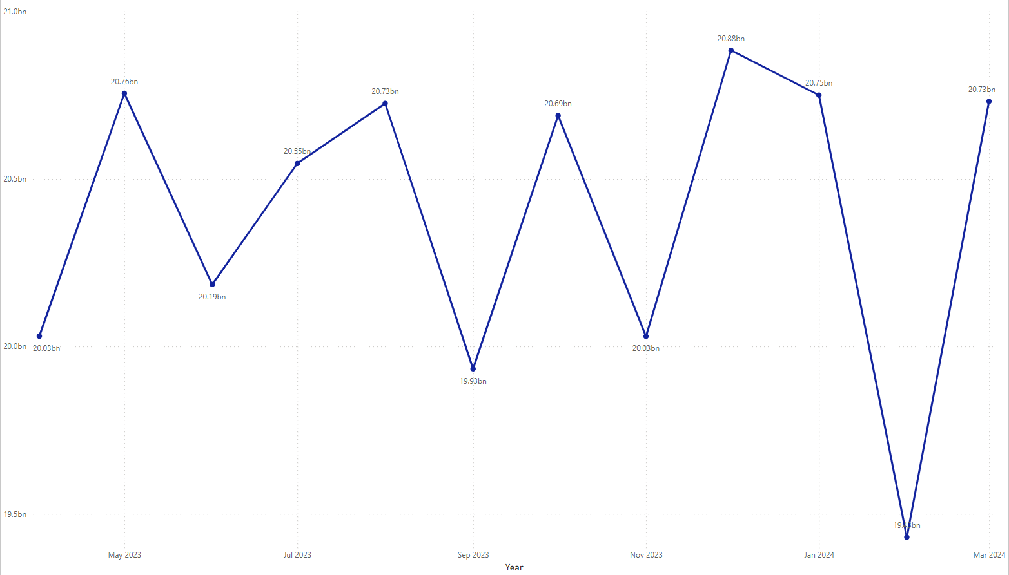
Healthcare Cost over Time
There is no significance trend in the healthcare cost over time as shown in the chart below. However, there is monthly cost variations with fluctuations over time.
Thus, there is no significance seasonal patterns in healthcare utilization and cost to help us make predictions for future trends.

Slide 4
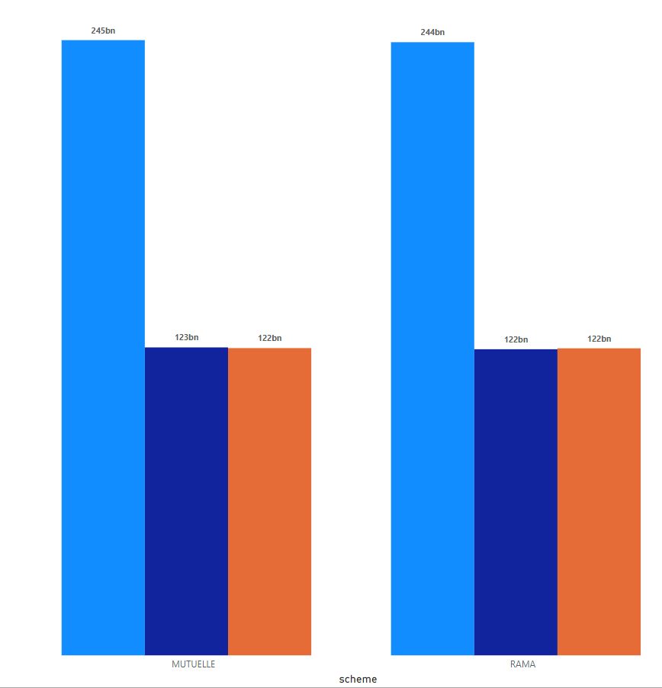
Costs Per Scheme
Generally, Mutuelle scheme drives higher cost compared to Rama with a difference of over 1billion.
Mutuelle accounts for more than 245bn while Rama accounts for 244bn

Slide 5
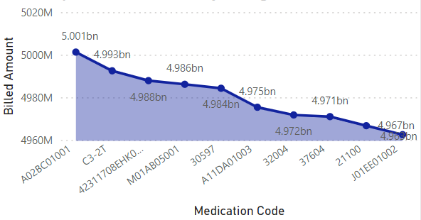
Top 10 Medication Cost based on the Average Billed Amount
The top 10 Medication lead by A02BC01001 are driving high cost with over 45billion of the billed amount. This can be attributed to the diagnosis discovered above. However further investigation is need to ascertain this and if they are related.

Slide 6
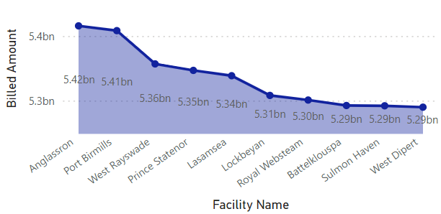
Top 10 Facilities With high Health Cost Based on Billed Amount
In terms of facilities, Anglassron and Port Birmills are billing high amount over 5.4billion over the period. The top 10 facilities accounts for more than 60billion of the total cost as shown in the chart below.

Slide 7
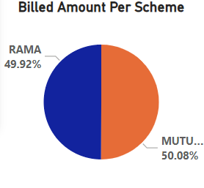
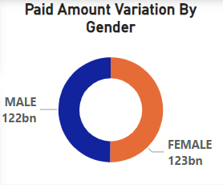
Cost Comparison for Scheme and Gender based on Billed and Paid Amount
Also, male customers drive high cost of healthcare compared to female. The account for more than 50% of the total billed and paid amount while females account for less than 50%.
Generally, Mutuelle scheme accounts for a higher cost percentage compared to Rama with a difference of over 1billion.

Slide 8
Recommendations
In light of the analysis findings from the medical claims data, the following recommendations are proposed to optimize cost management and improve the efficiency and quality of healthcare services
Investigate discrepancies in payment verification to understand why an amount paid exceeded the verified amount, ensuring accuracy and transparency in financial transactions.
Monitor monthly cost fluctuations to identify emerging patterns and trends over time, facilitating proactive decision-making and resource allocation to address changing healthcare needs and market dynamics.
Explore the reasons behind gender-based differences in healthcare costs to identify areas for targeted interventions or healthcare management programs tailored to specific demographic groups.
Further investigate high-cost diagnoses and medications in collaboration with healthcare providers to identify opportunities for cost containment, such as negotiating lower prices or exploring alternative treatments.
Conduct a detailed analysis of the benefits, coverage, and utilization patterns under each insurance scheme to inform resource allocation and policy adjustments for optimizing cost-effectiveness and equitable access to healthcare services.
Evaluate high-billing facilities to determine factors contributing to their high billing amounts, enabling identification of areas for cost-saving measures and optimization of resource utilization.

